Slide 1
University Management System
Subject: Database Management Systems (DBMS)

Slide 2
Group Members
Muhammad Abdur-Rehman (FA20 BSCS 022)
Fakhar E Alam (FA20 BSCS 023)

Slide 3
Introduction of Project
This Project is about University Management System In this Project I will show you the features of University Management that how University manage his Students, Teachers and How they maintain Students , staff ,faculty Records and some Multiple other Quires regarding to University Management. We done this Project in C# Language with Microsoft SQL Server.

Slide 4
Features
Teacher Sign In
Student Sign In
Management Sign In
Courses
Announcements
Add Teacher
Add Student
Assignments
Quizzes
Dashboard
Delete Functions
Update Functions
Student Report
Change Password
Searching

Slide 5
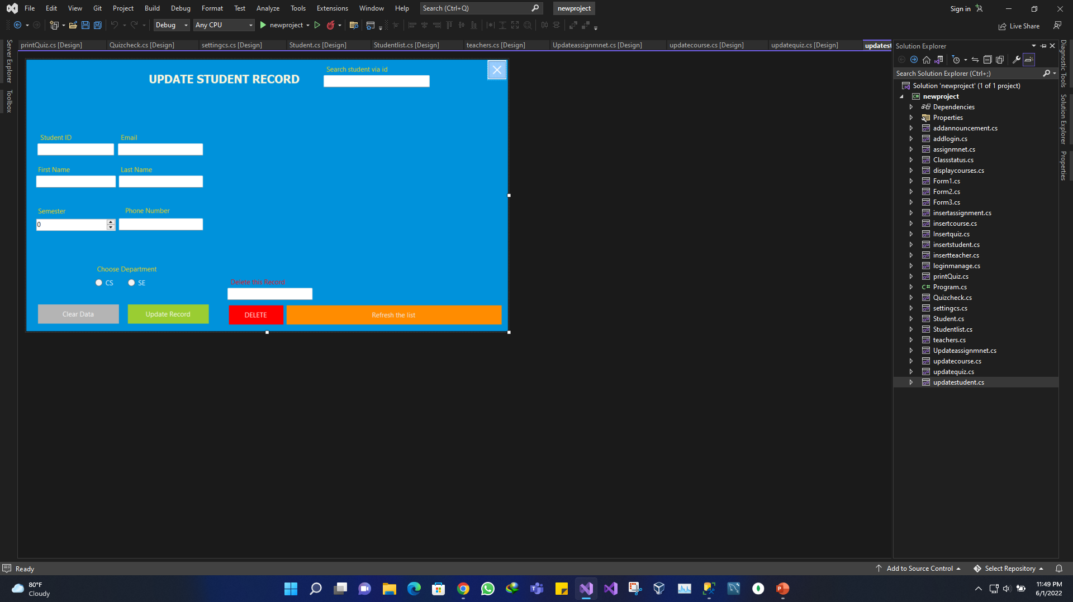
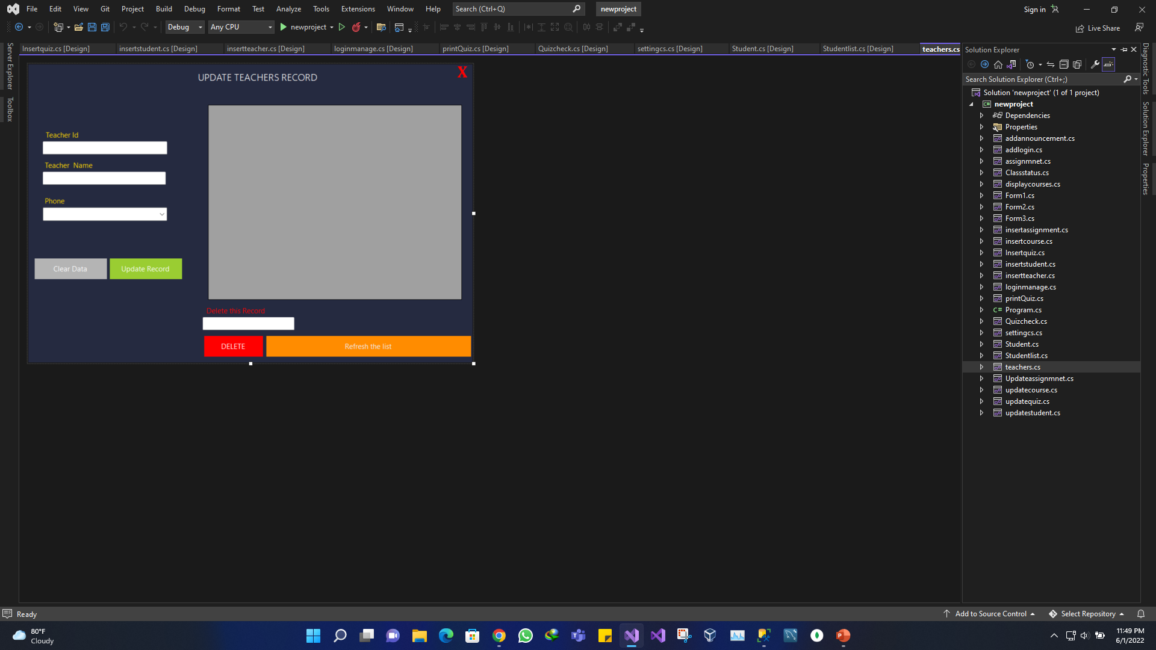
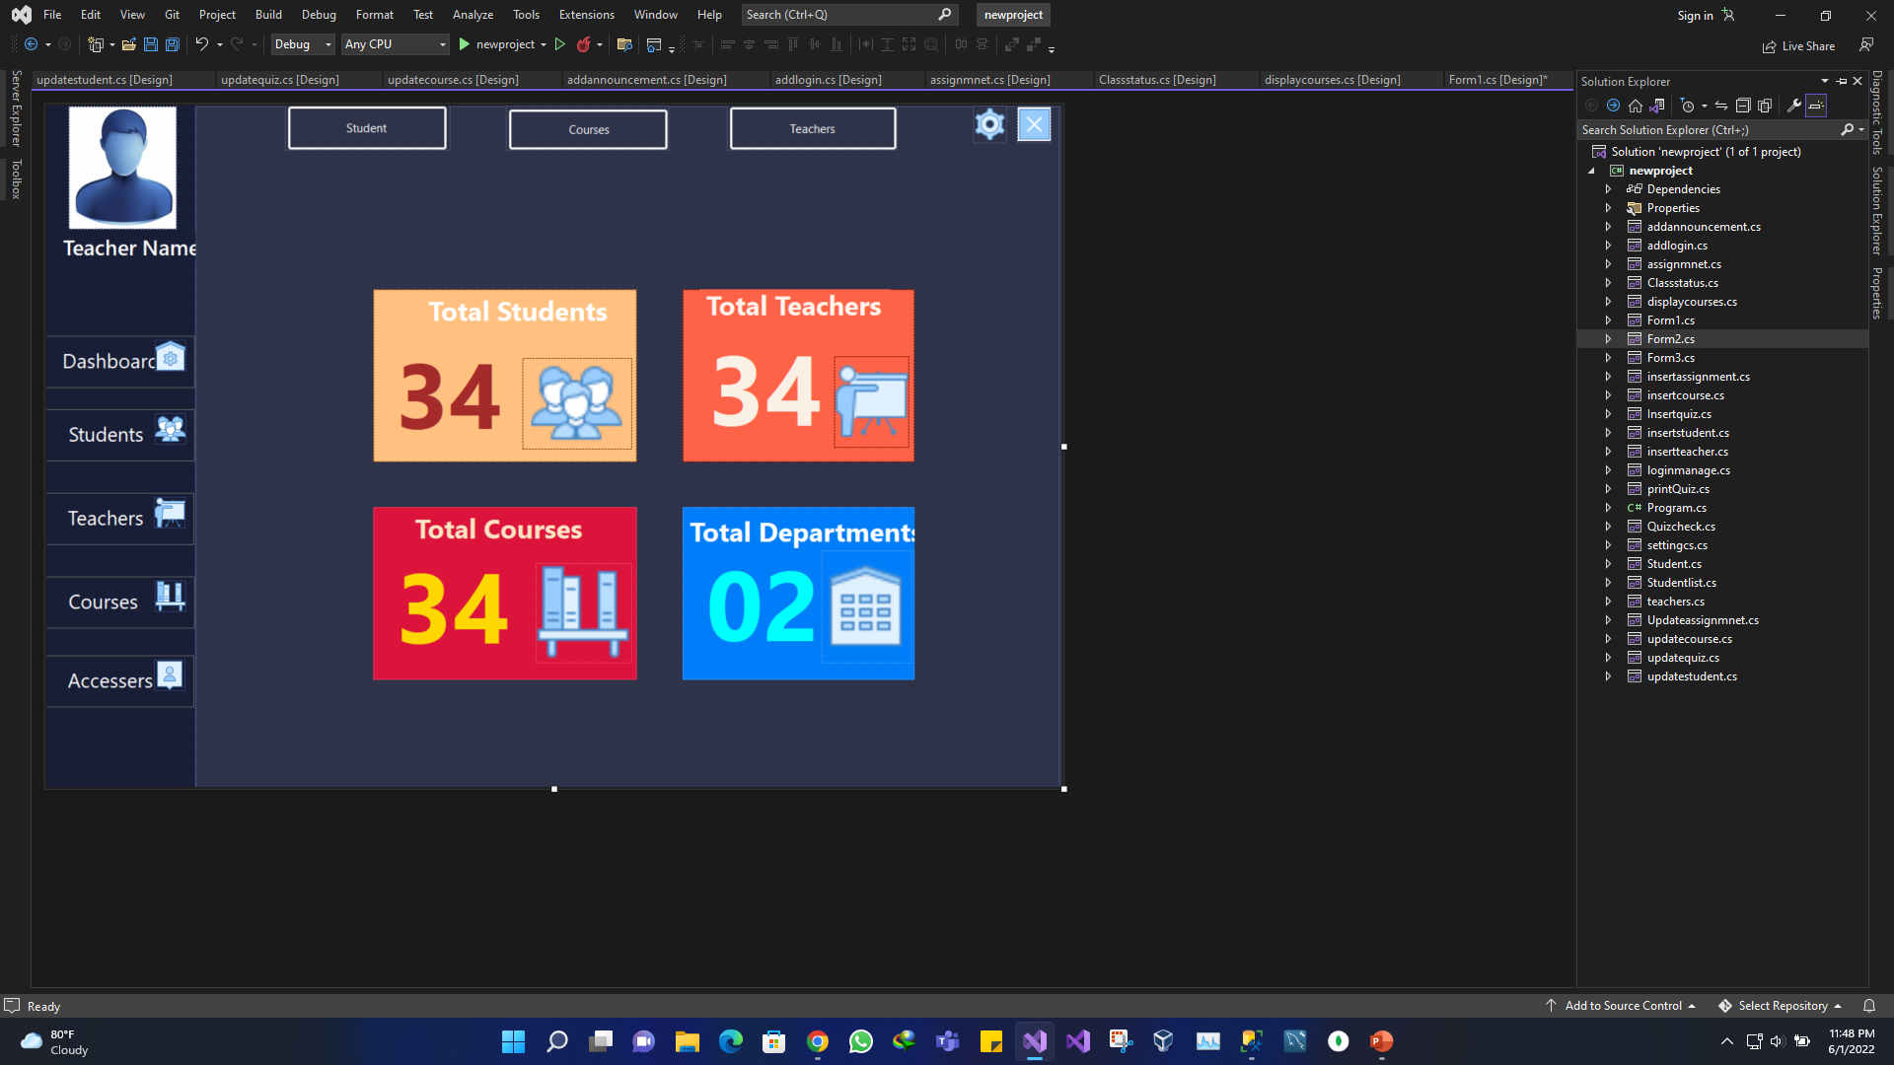
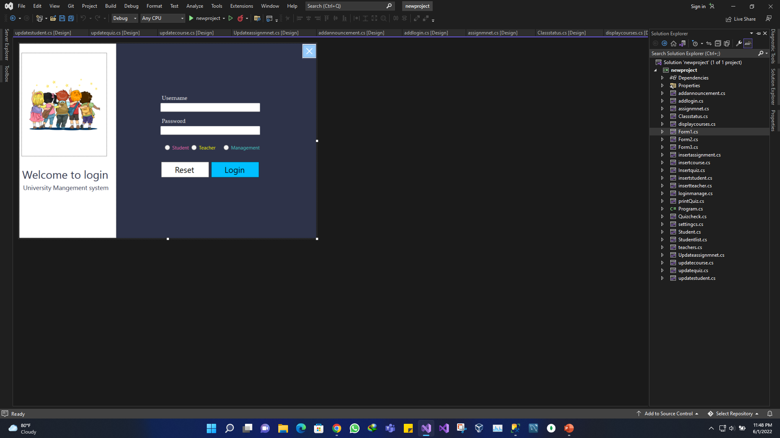
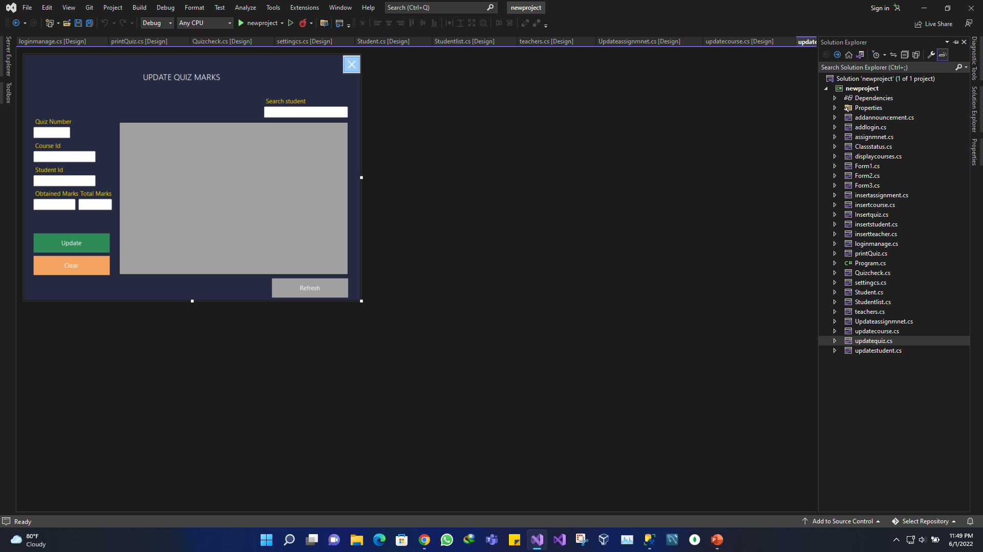
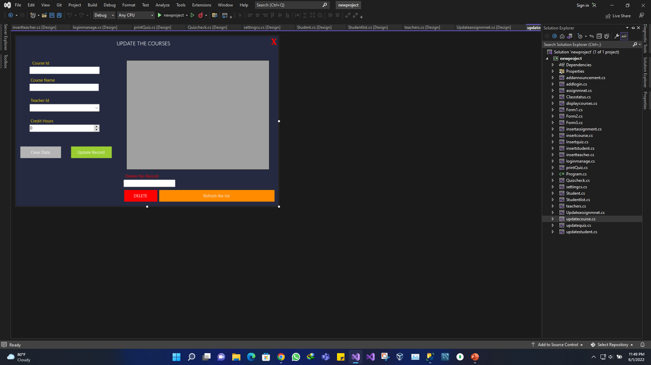
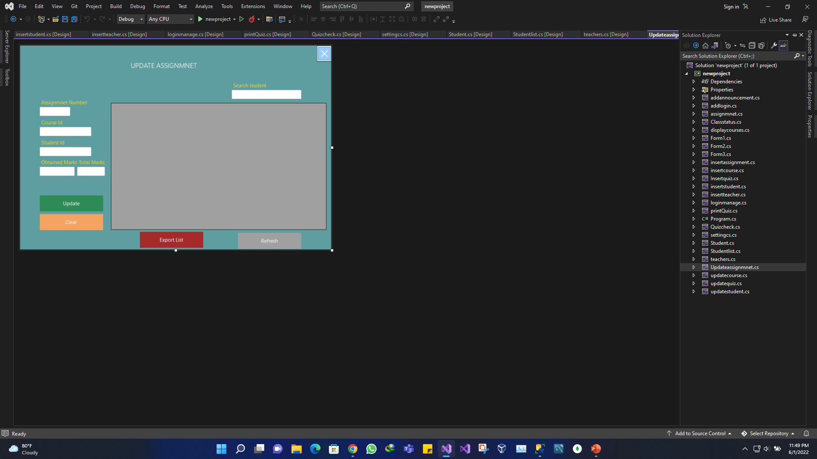
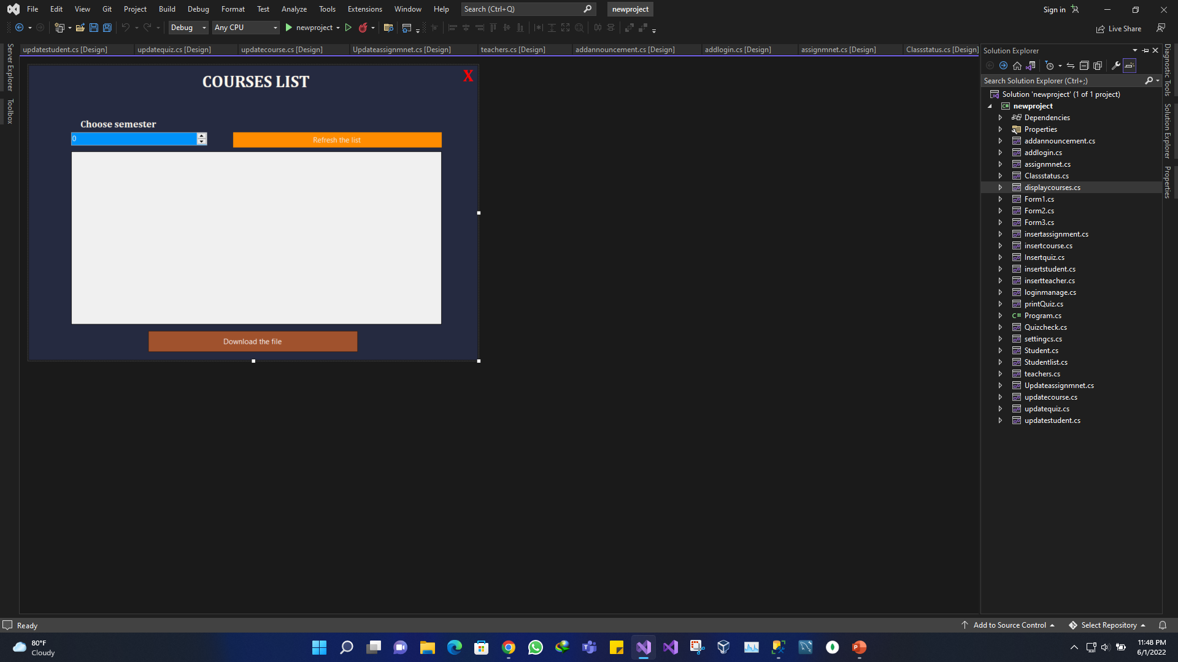
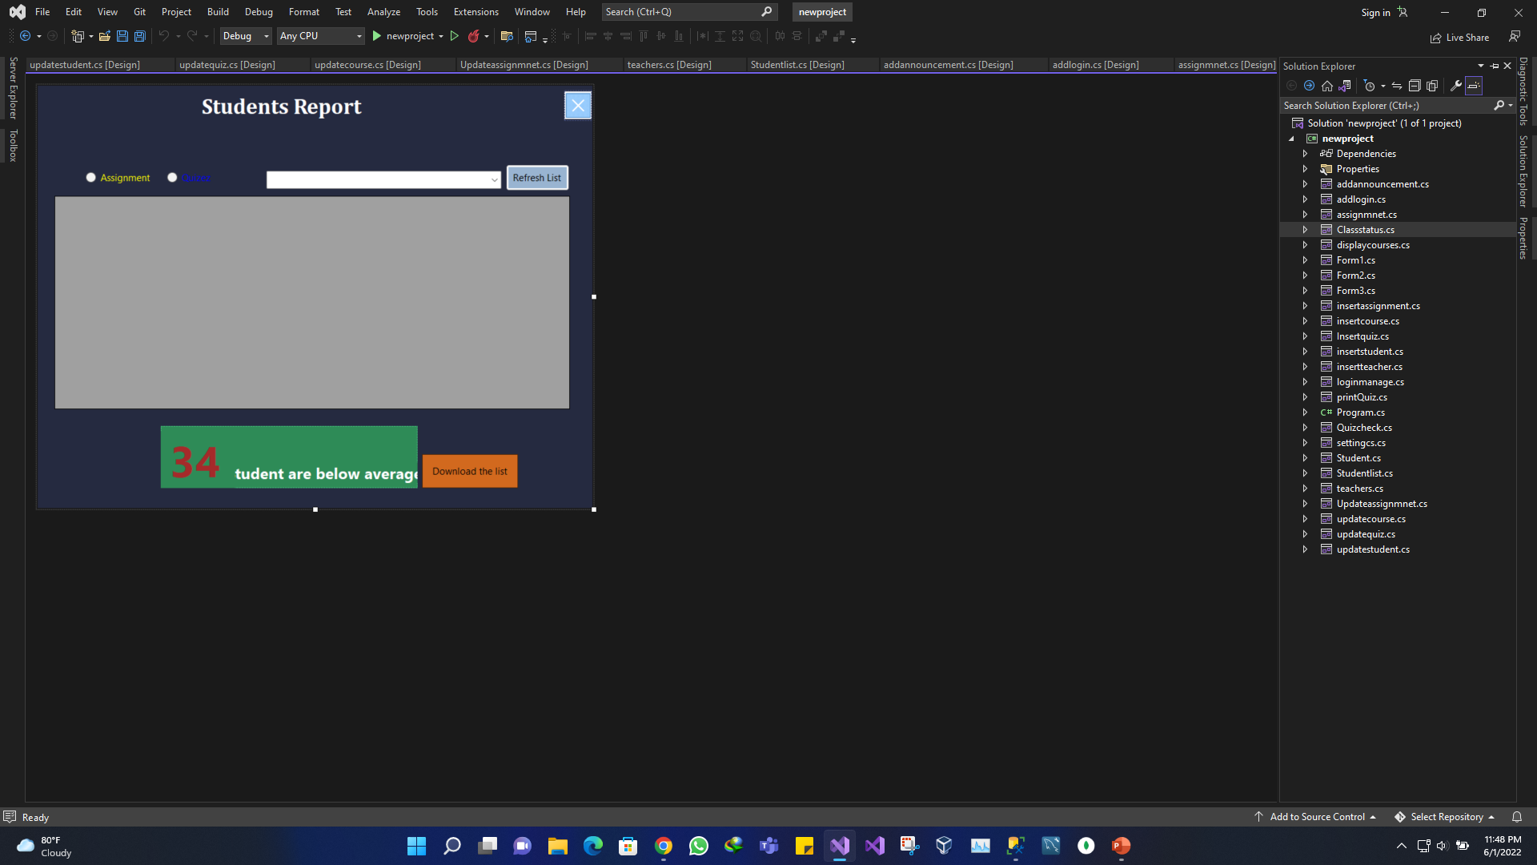
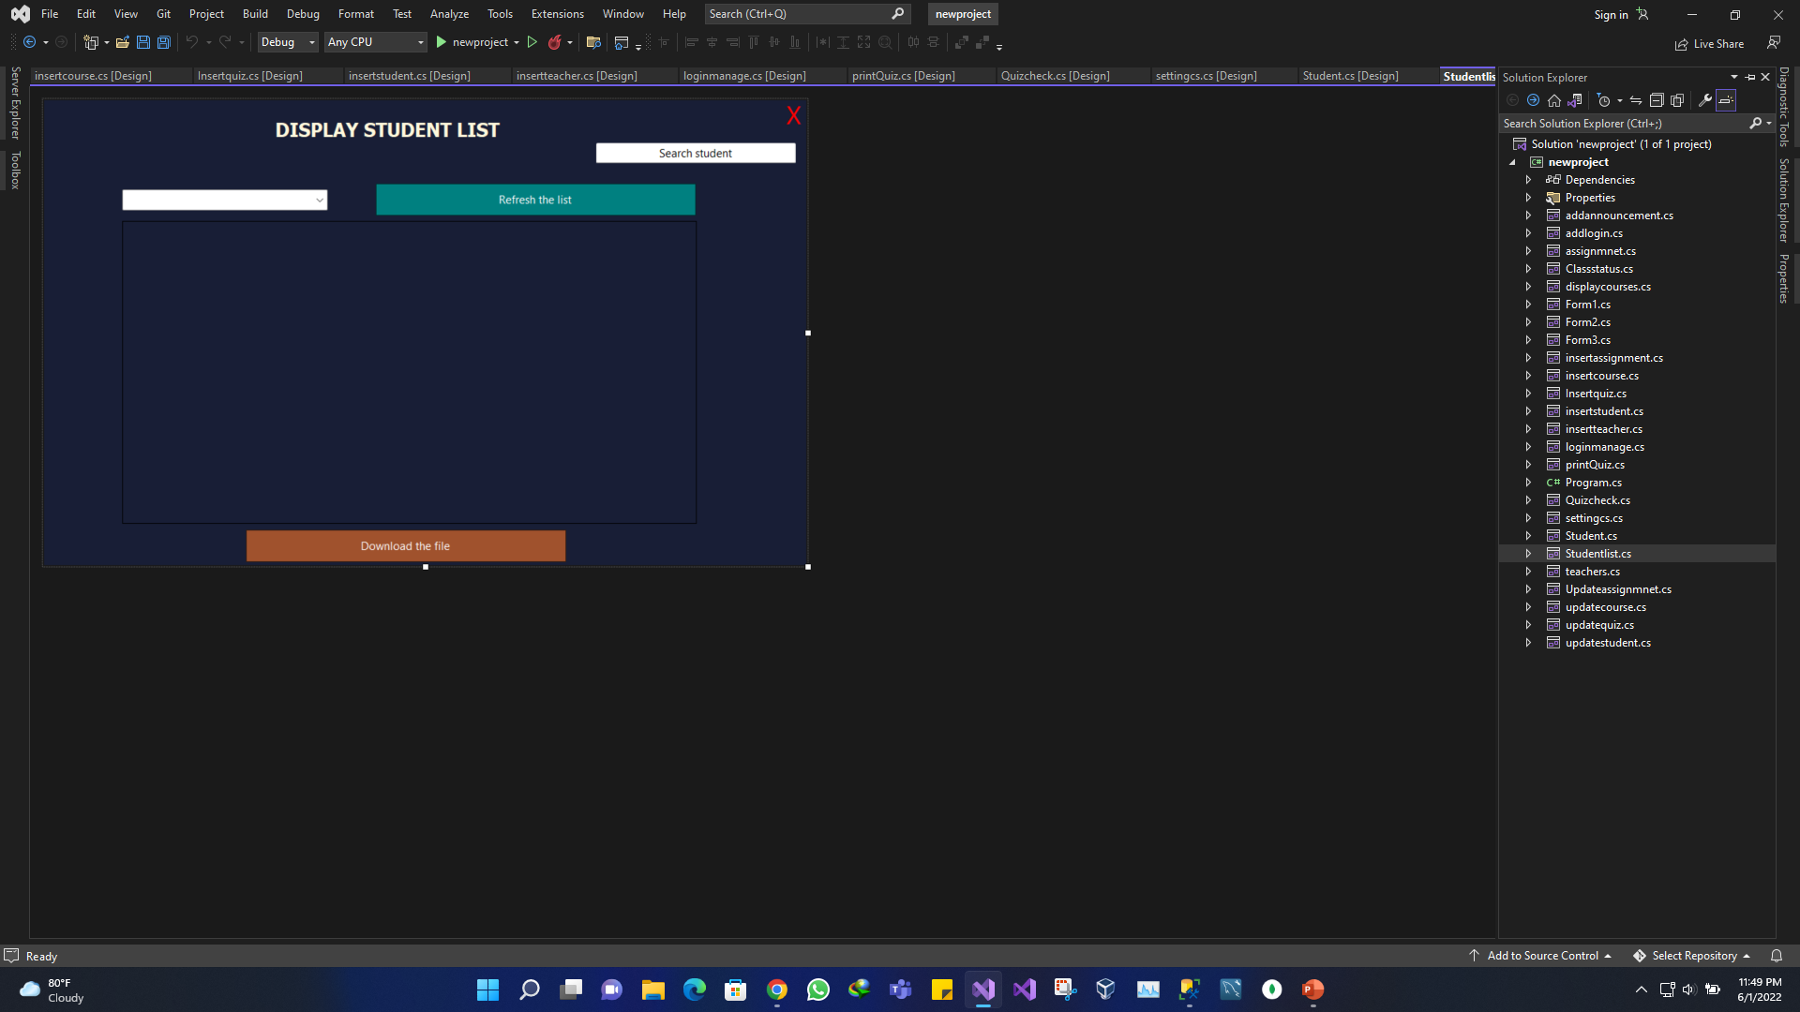
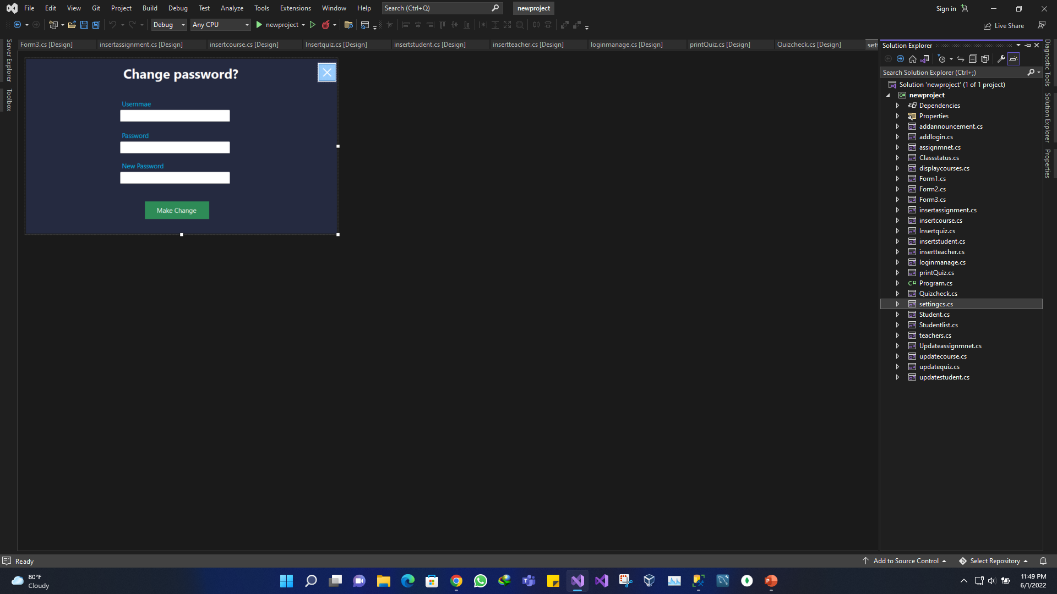
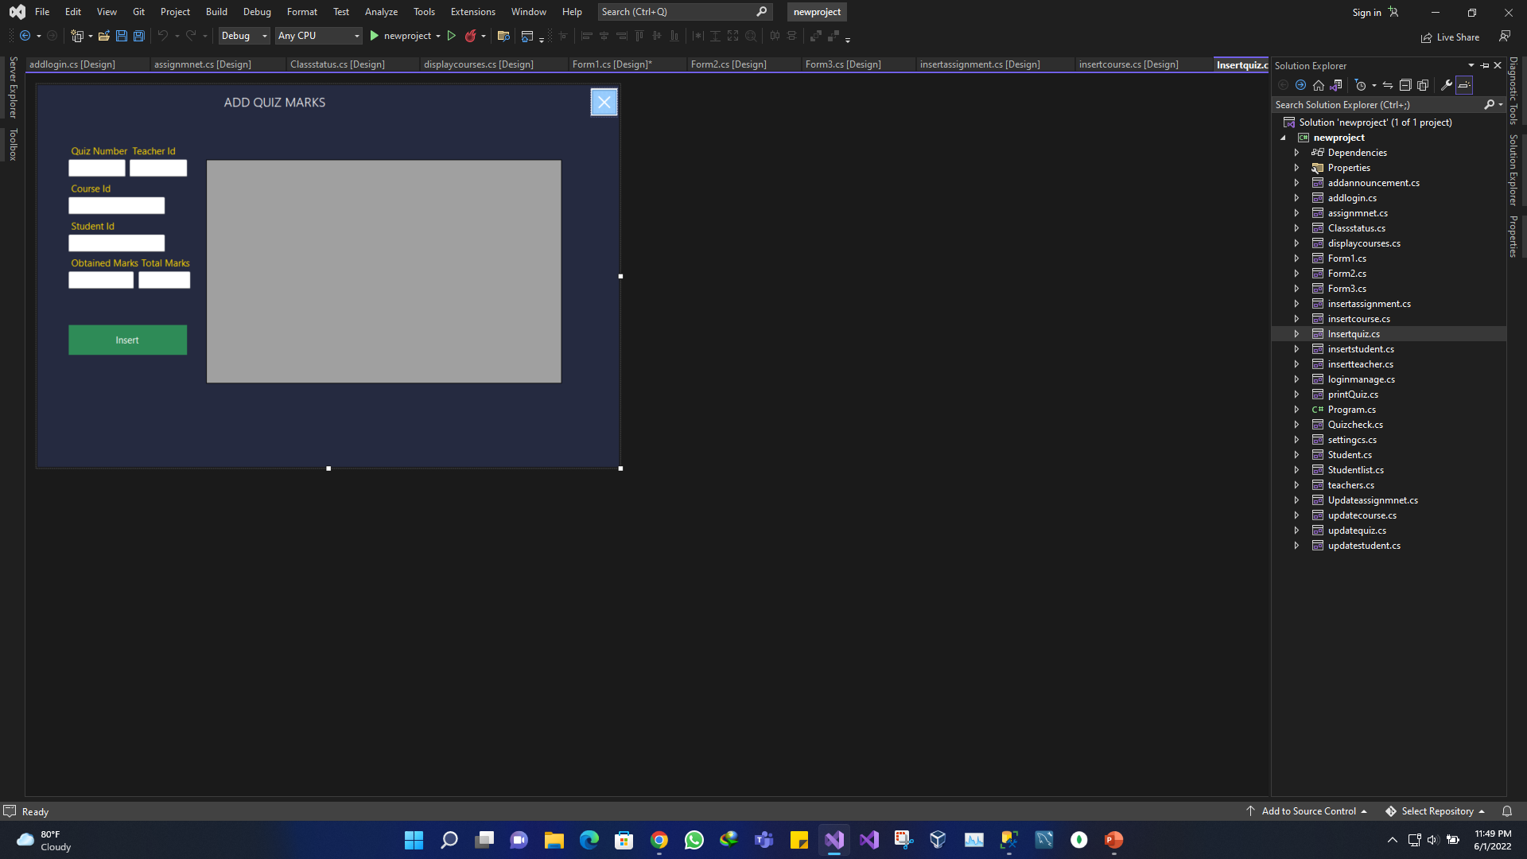
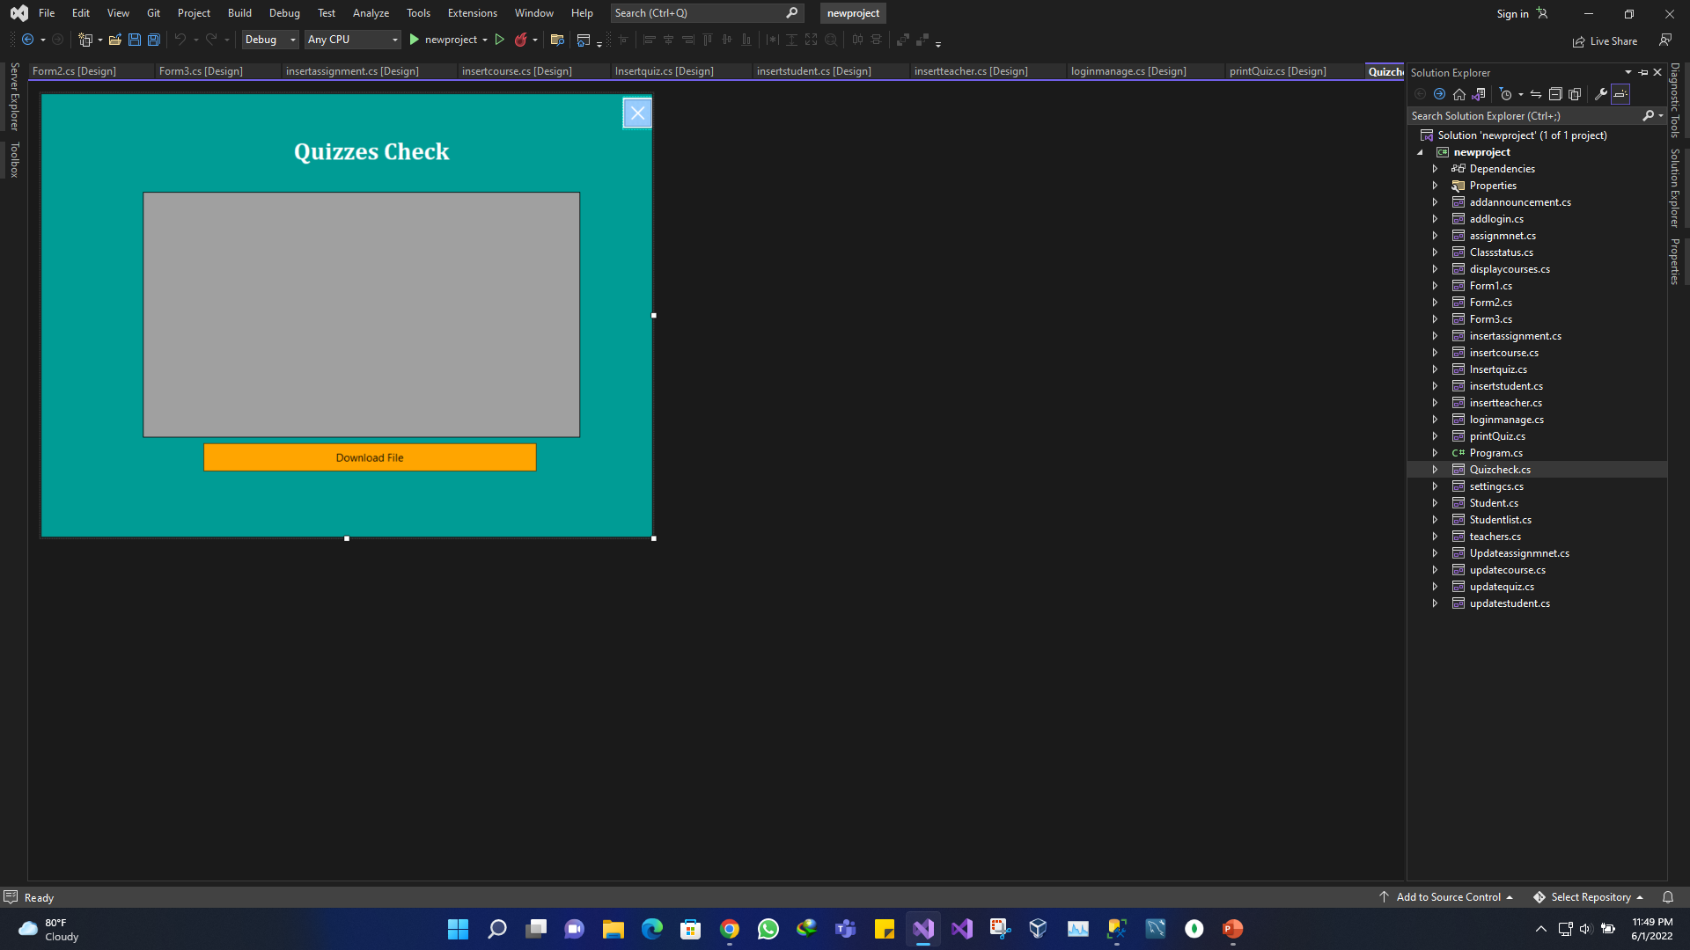
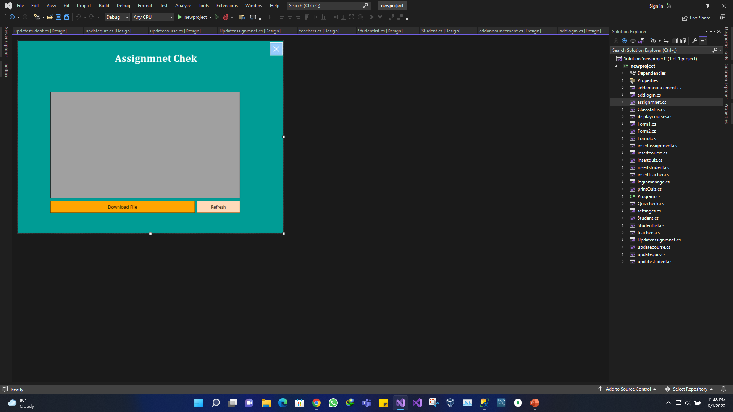
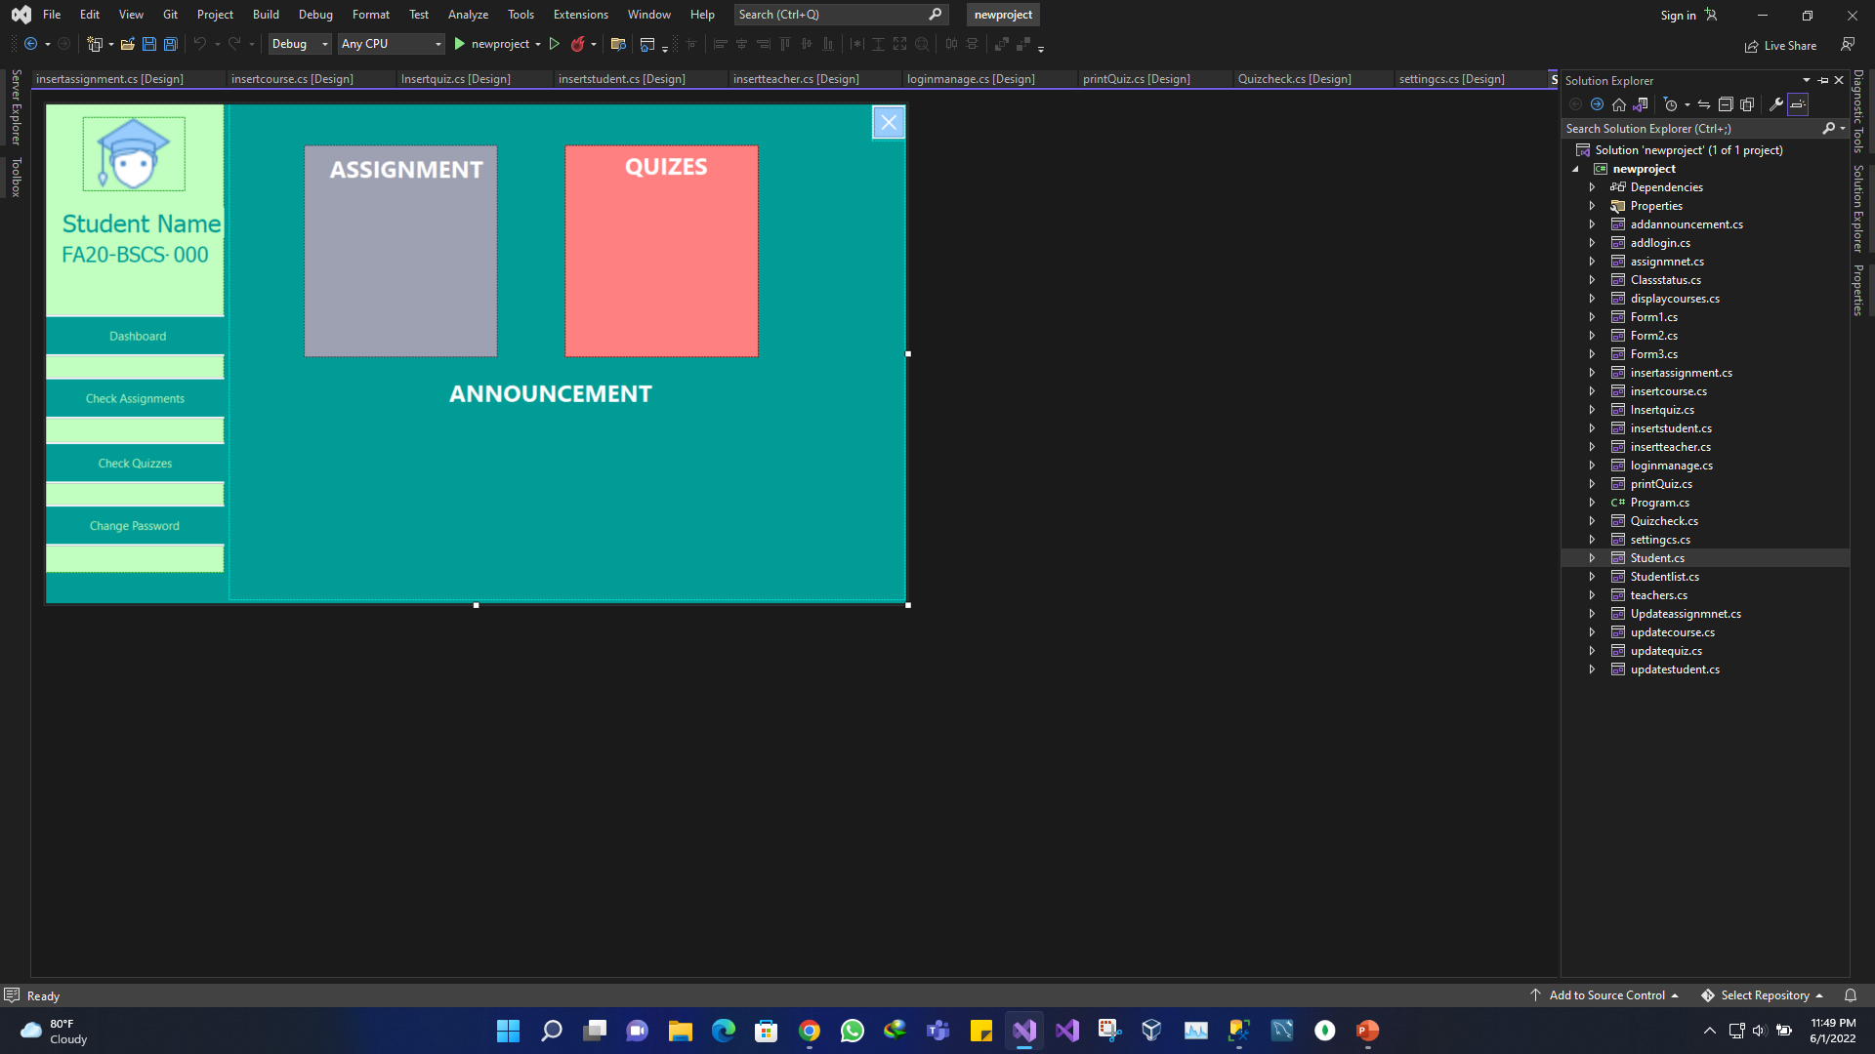
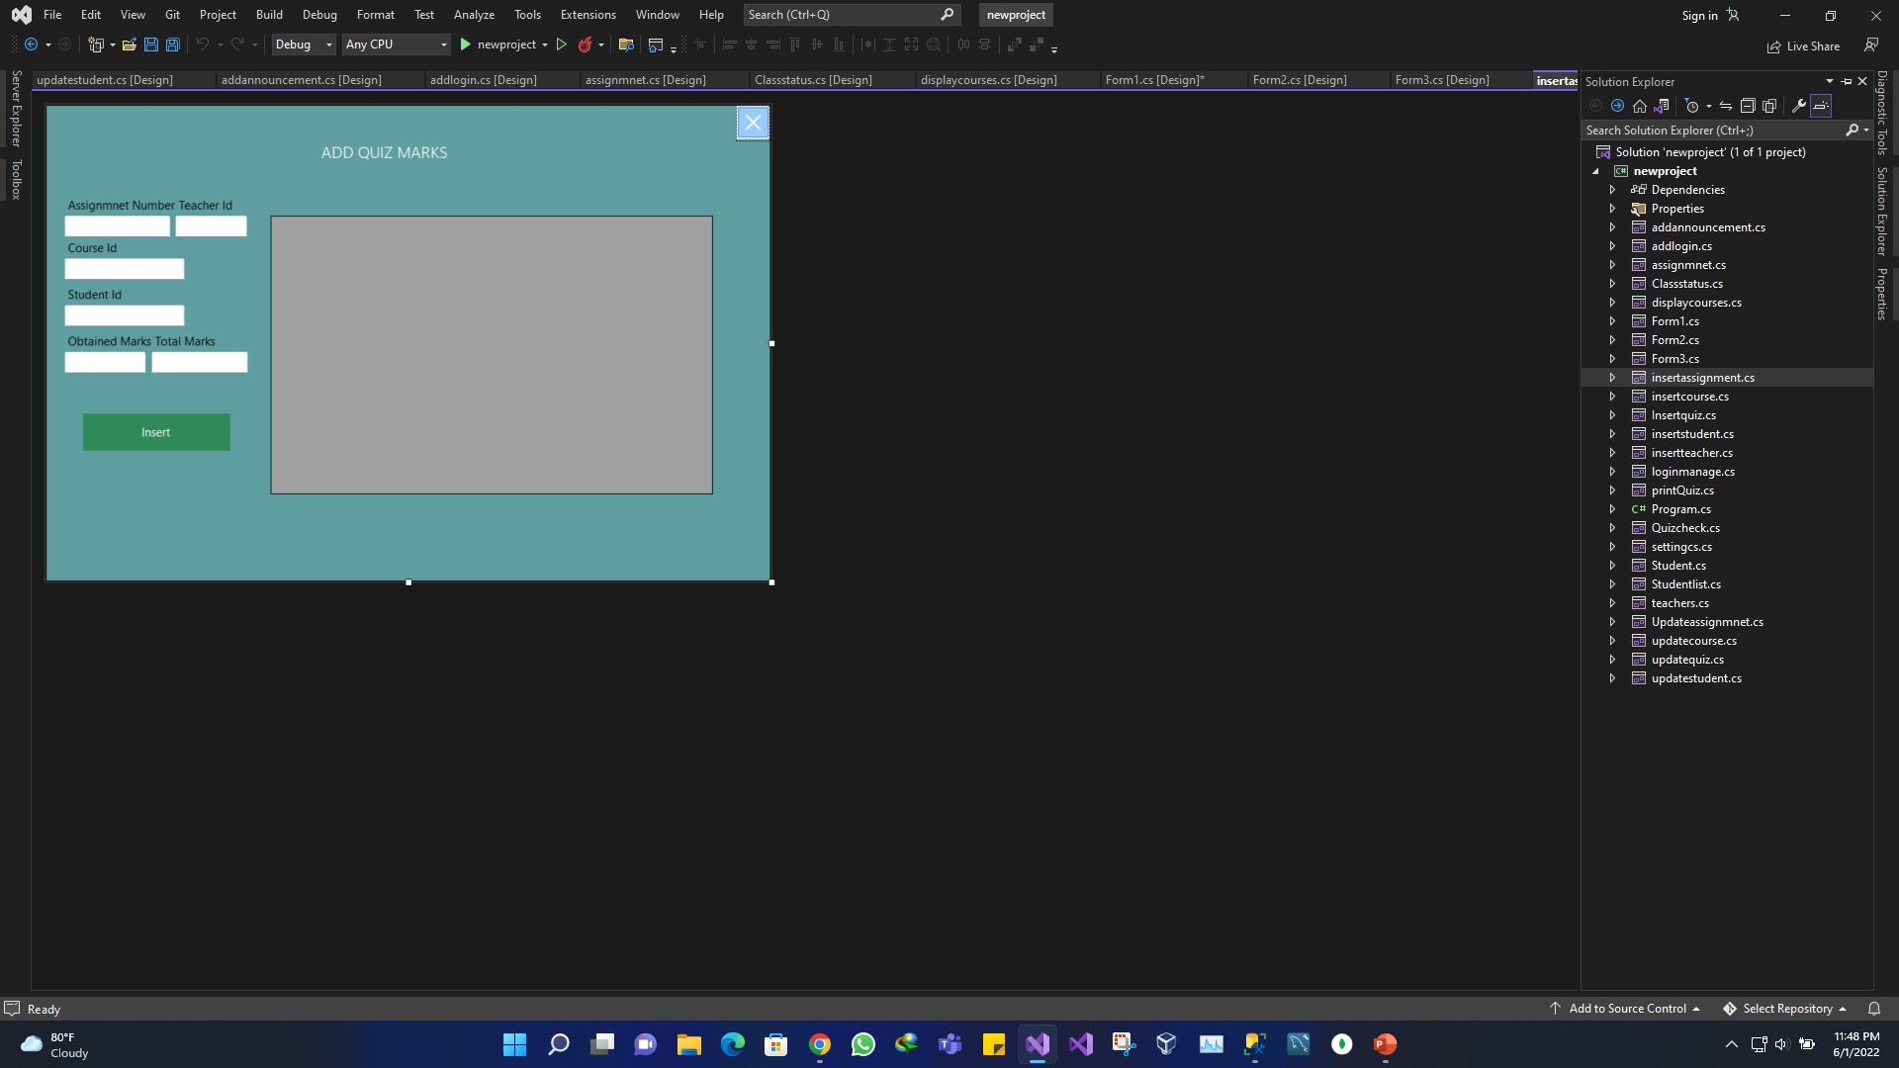
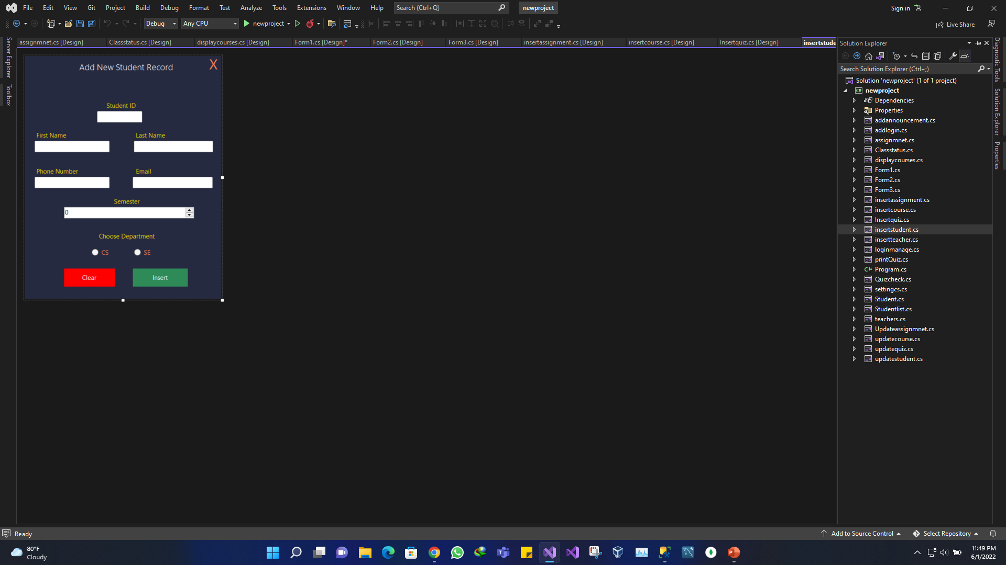
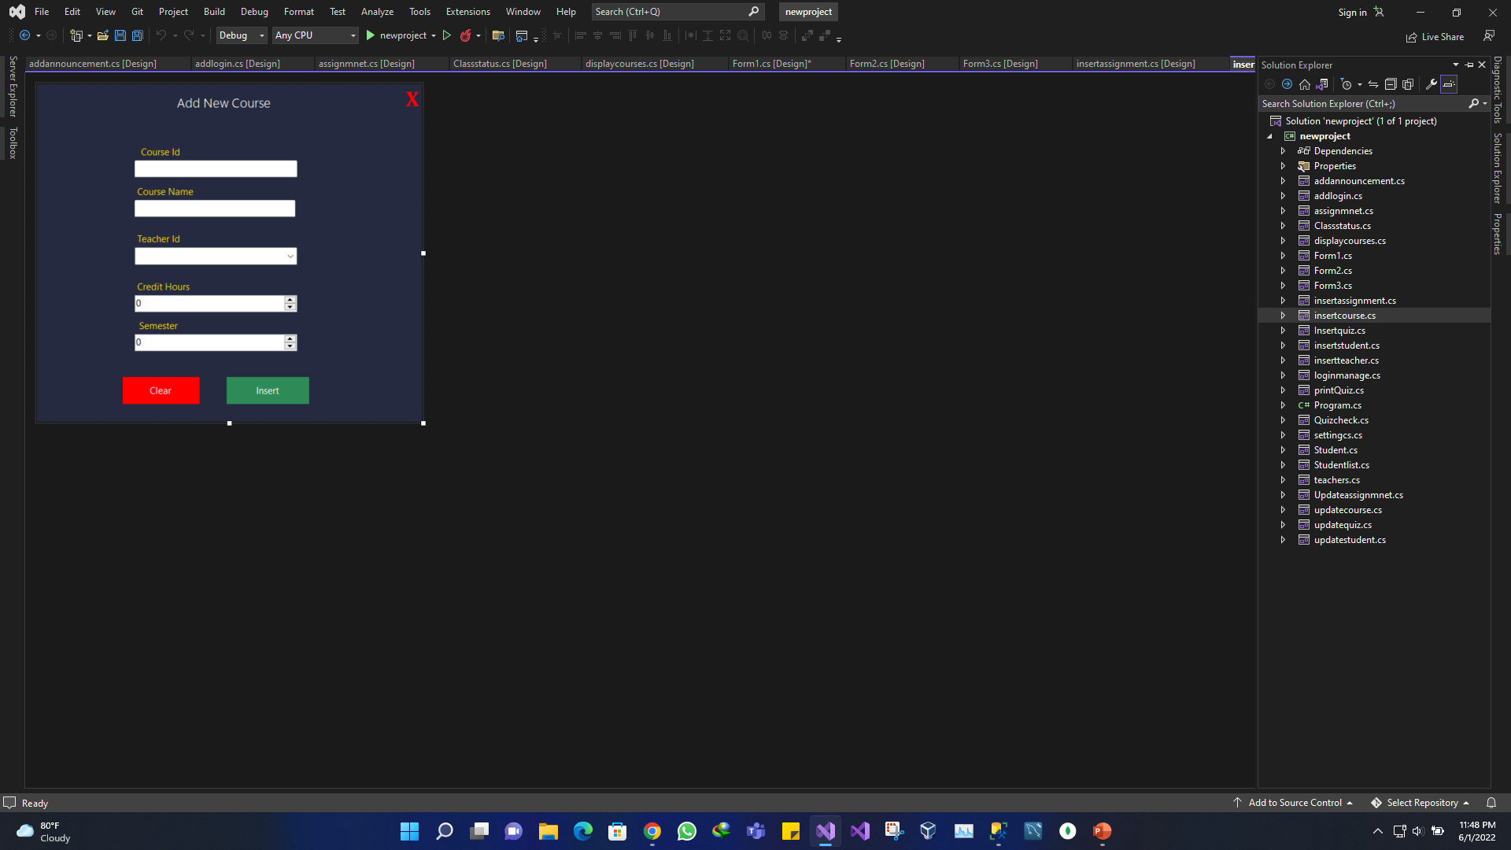
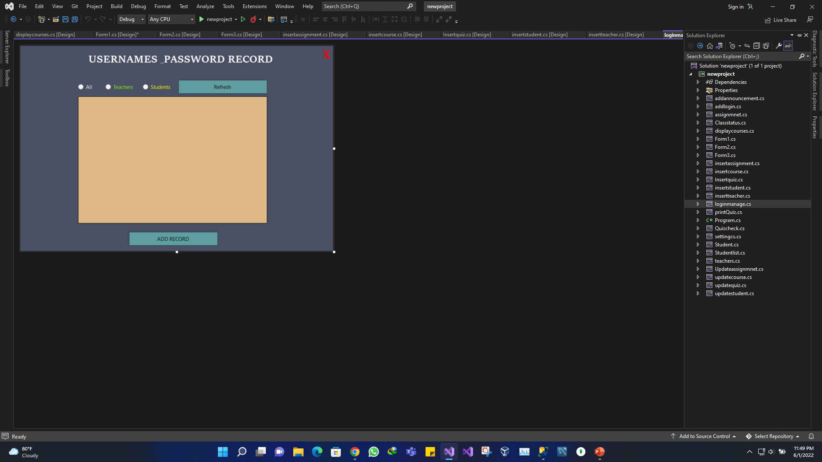
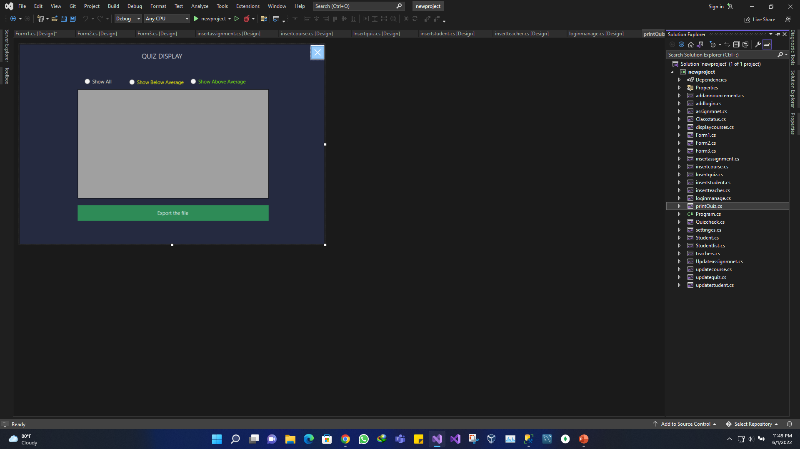
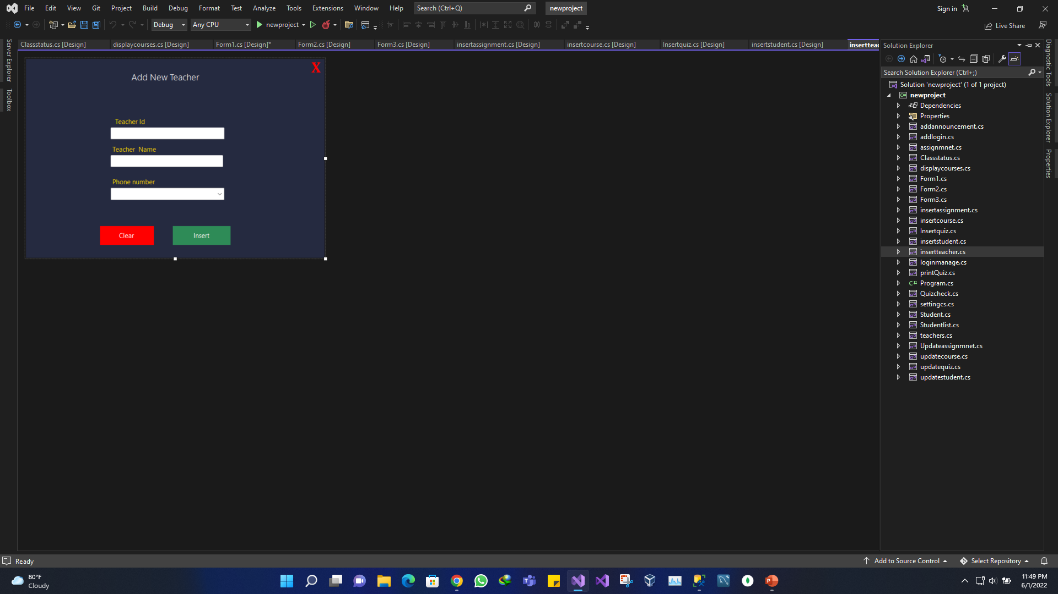
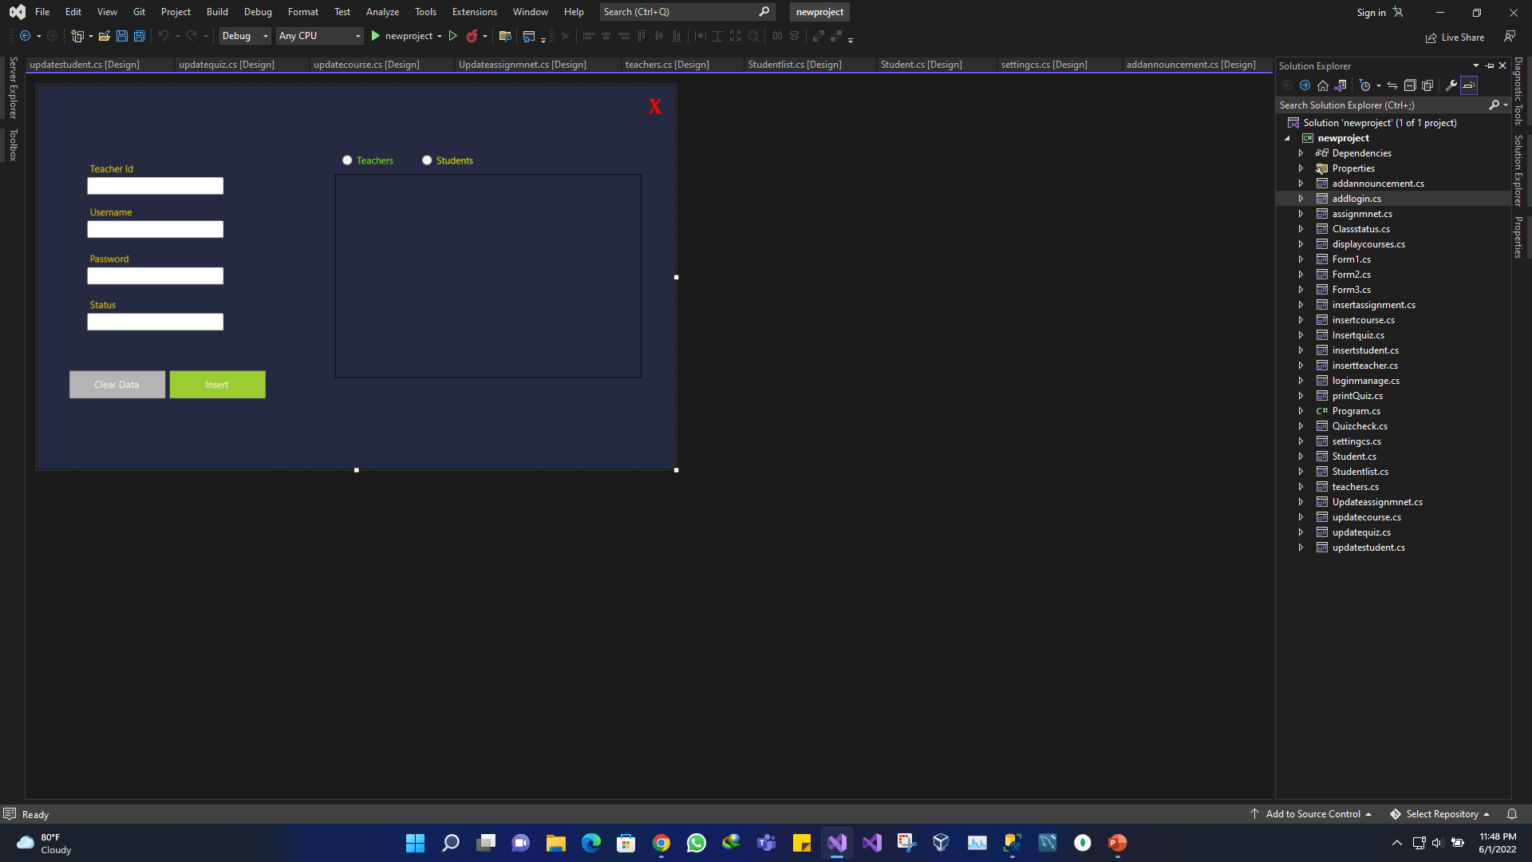
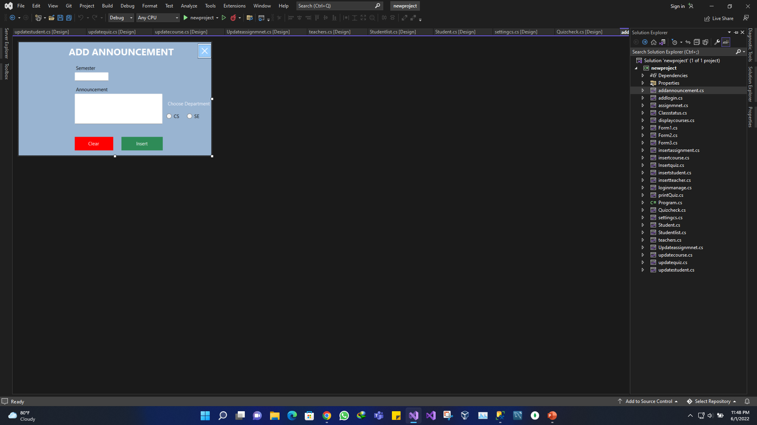

Slide 6
Reason
University management system (UMS) is a solution which covers all aspects of colleges, universities and schools. It is developed for conducting, monitoring & analyzing complex activities of the University and its affiliated colleges like Centralized Admission, Centralized Examination, and much more.

Slide 7
Work Division
Muhammad Abdur-Rehman (Front End & Back End)
Fakhar E Alam (Back End, Back End & SQL Database)

Slide 8
THANK YOU!

